Slide 1
COVID-19 SEIR-D MODEL
Simulation
~ GROUP 8 ~
Shaoqian Chen
Qinhao Chang
Tianxiao Yu
Wei Li

Slide 2
Index
Problem Description
Assumptions
Traditional SEIR model
Introduce SEIR-D model
Demo of Our Simulation Using AnyLogic
Further improvement

Slide 3
Problem Description
With the outspread of COVID-19, It is essential to build model to analyze COVID-19.
Objective: To establish a SEIR+D epidemic dynamic model that can be used to simulate the COVID-19 epidemic, and to predict and evaluate the COVID-19. Expand the area from California to three adjacent states, including Oregon and Nevada via the proposed model. Also, play with contact rate to explore what benefits might there from instituting "shelter-in-place" for two weeks.
Health care resources are limited and essential. Thus, predicting the amount of usage and shortage plays a significant role in COVID-19 analysis.

Slide 4
Assumptions
We will use 3.4% as fixed Mortality Rate which estimate by the World Health Organization (WHO) as of March 3
We assume average incubation time is 15 days fixed through the process.
We ignore the infectious who has no symptoms;

Slide 5
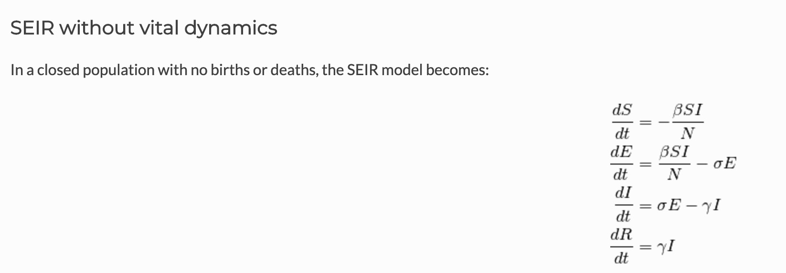
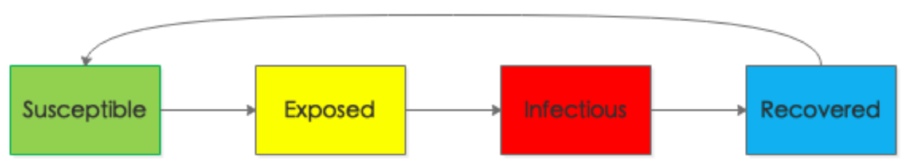
Introduction of Traditional SEIR Model
Traditional model

Slide 6
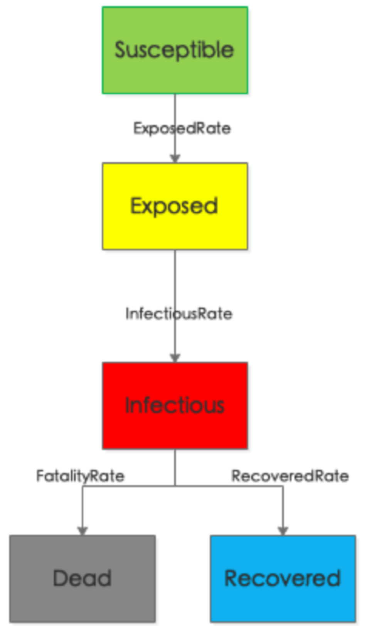
Introduce SEIR-D Model
ExposedRate = Infectious*ContactRateInfectious*Infectivity*Susceptible/TotalPop
InfectiousRate = Exposed/AverageIncubationTime
RecoveredRate = Infectious/AverageIllnessDuration
FatalityRate = Infectious*Fatality/AverageIllnessDuration
ReturnRate = (Still working on it)

Slide 7
Demo

Slide 8


Slide 9
Future Improvement
Use traffic data across three states to predict Exposed Rate
https://www.lvcva.com/stats-and-facts/visitor-statistics/
Use hospitality data to predict Fatality and Recovered Rate
https://covid19.healthdata.org/united-states-of-america
Include people who recovered but become infectious again into our simulation;

Slide 10
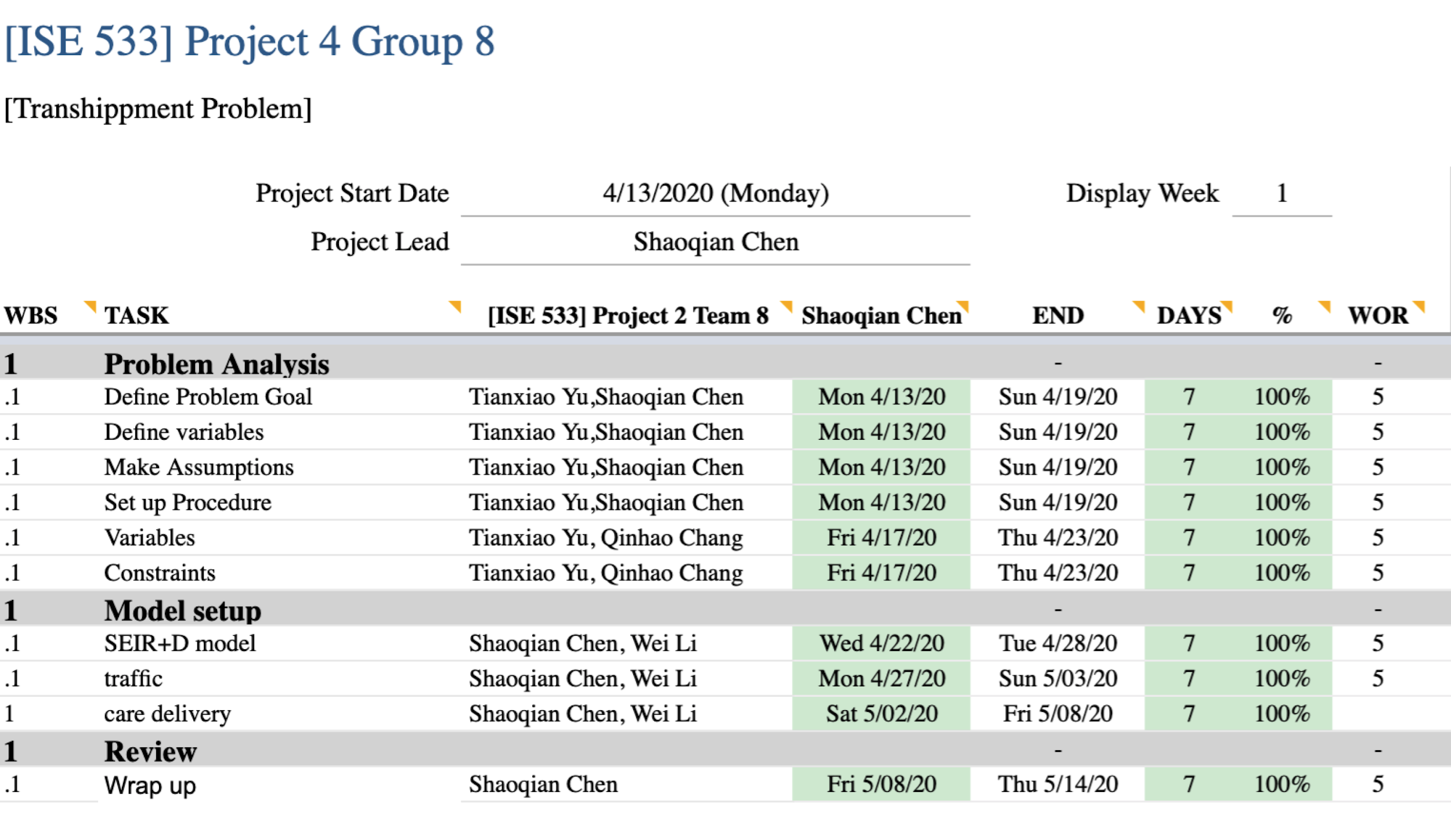
Timeline

